Slide 1
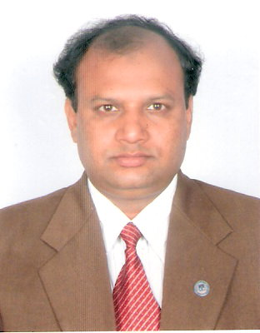


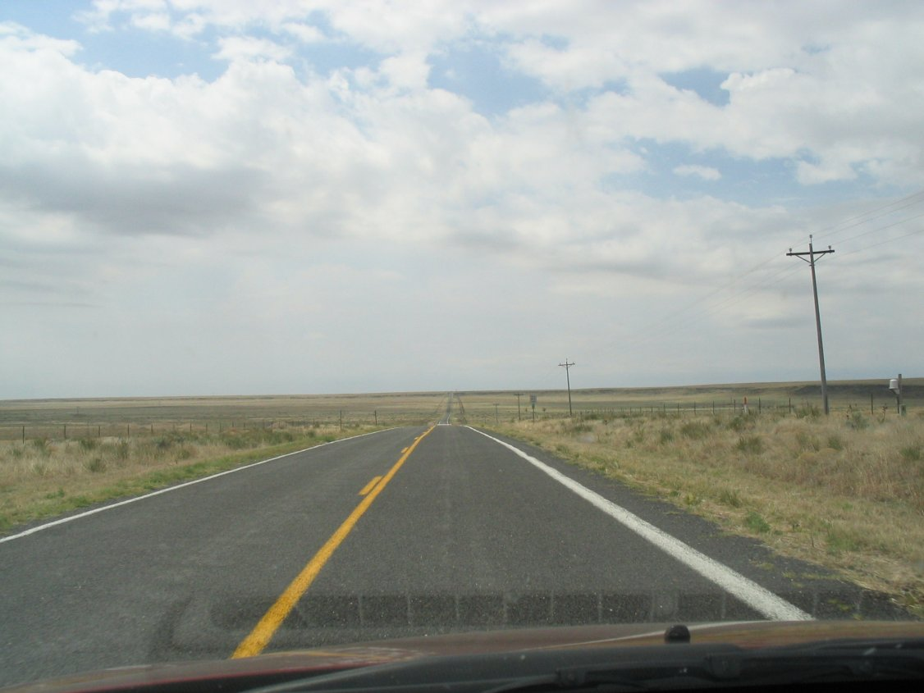
CEP 758, Spring 2008
Mokter Hossain

Slide 2

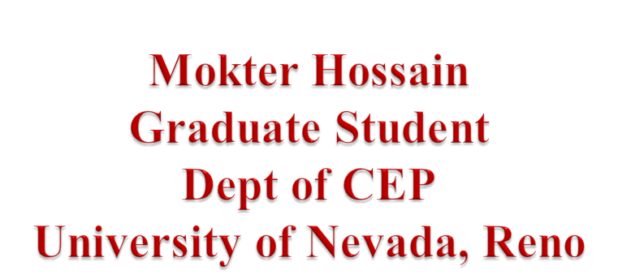

CEP 758, Spring 2008
Mokter Hossain

Slide 3

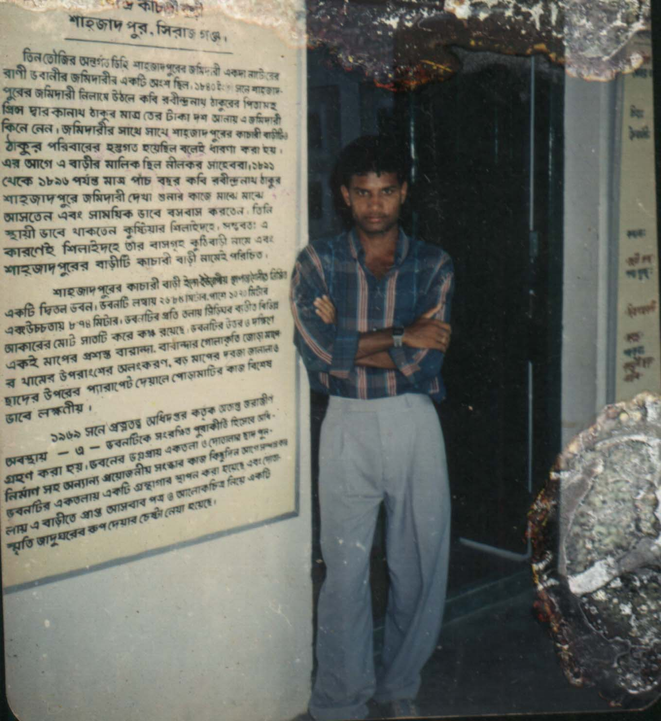

My Name is Mokter Hossain
I was born in Bangladesh in 1973
Now I am a Grad Student at UNR
So I am on the way to be a Doctor!

Slide 4


I got Bachelor degree on Mathematics in 1993
And a Masters in Computer Science in 1996
In Fall 2007 I got Admission in the dept of CEP
My Major is IT in Education

Slide 5

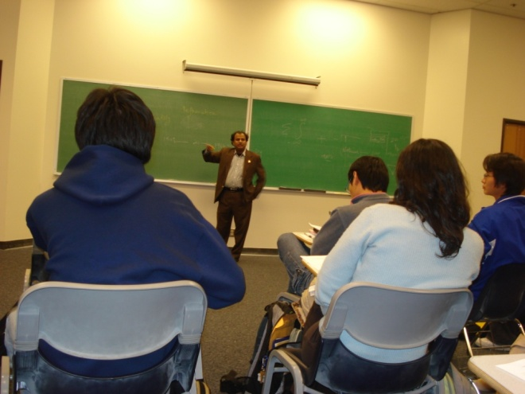
2.5 Yrs at the University of Comilla, Bangladesh
7 Yrs at the University of Dhaka, Bangladesh
Since Fall 2007 I have been working as a Teaching Assistant in the dept of CEP at UNR

Slide 6



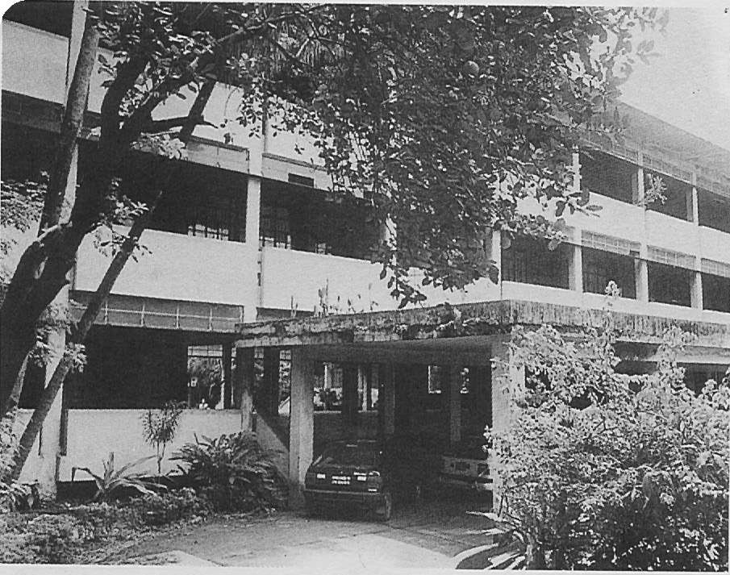
Established in 1921
More that 1000 Acors
About 50 Dept. and Institutes
About 30,000 Students
20 Residential Halls

Slide 7
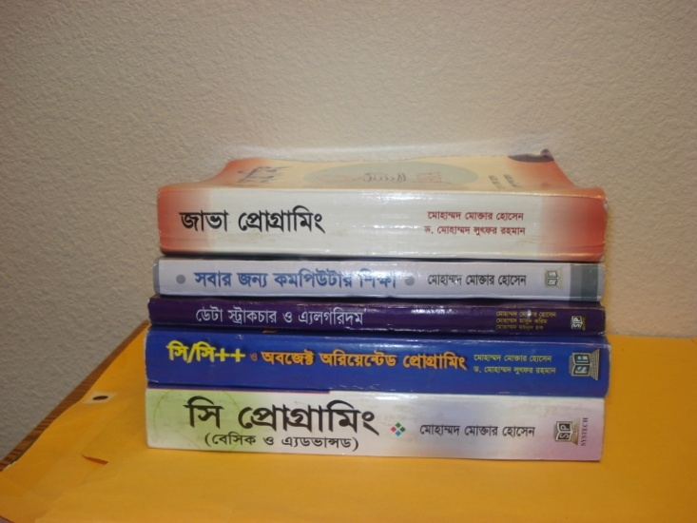


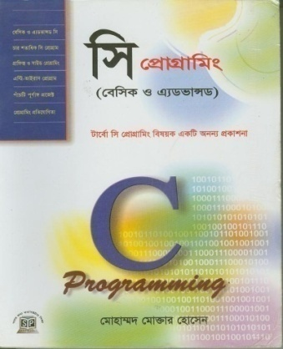
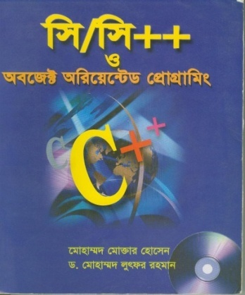
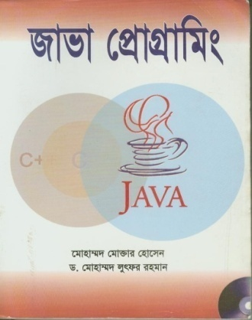
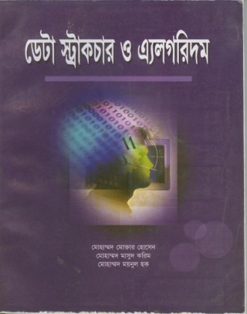
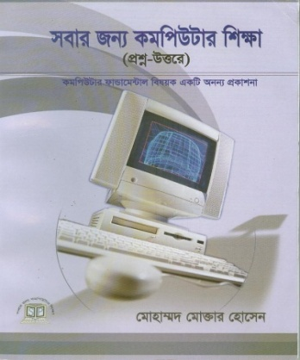
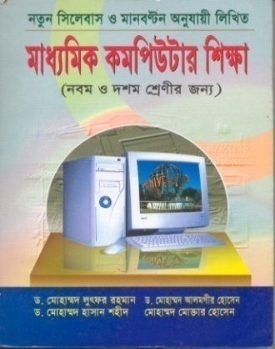
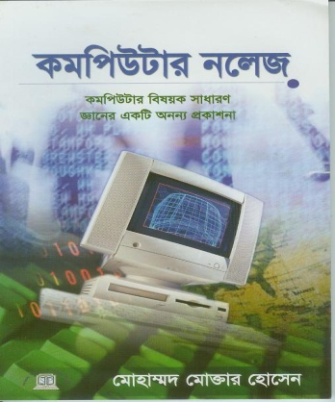
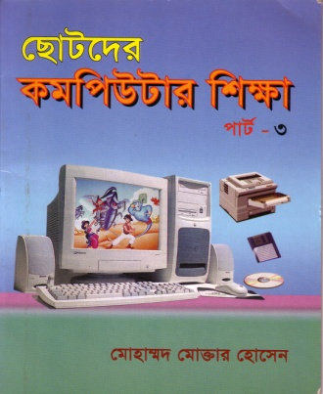
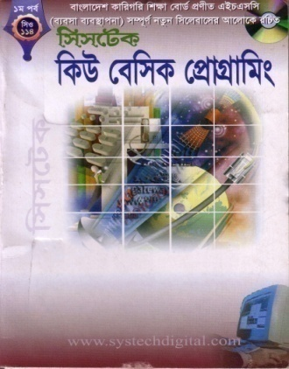
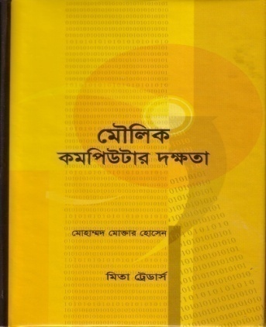

Slide 8

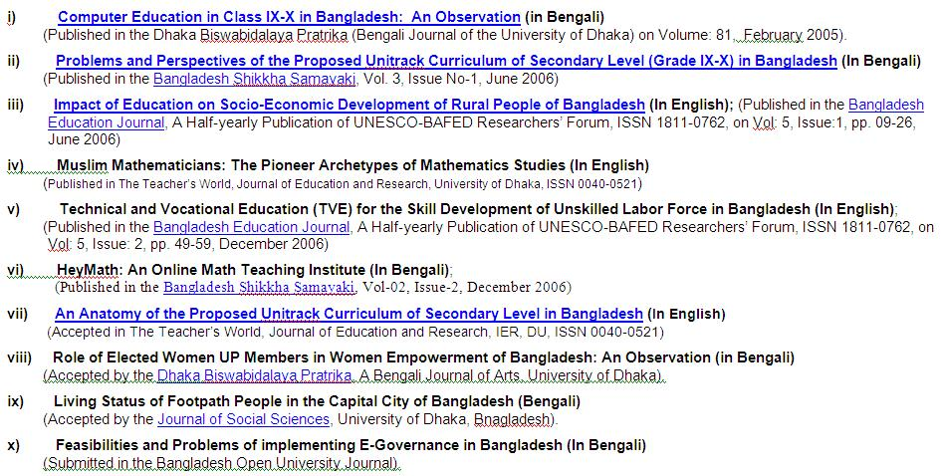

Slide 9

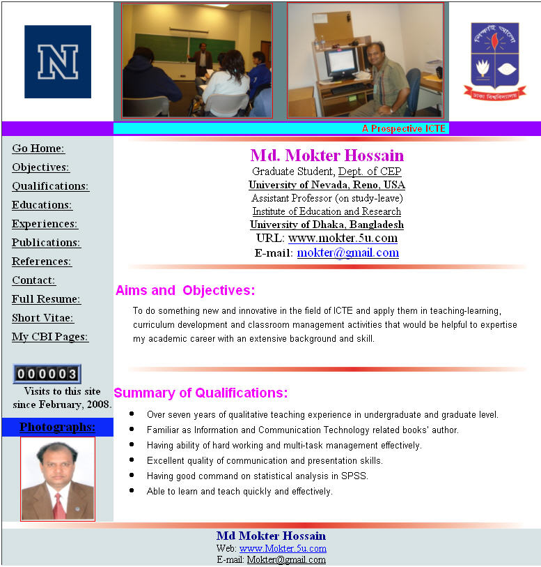

Slide 10

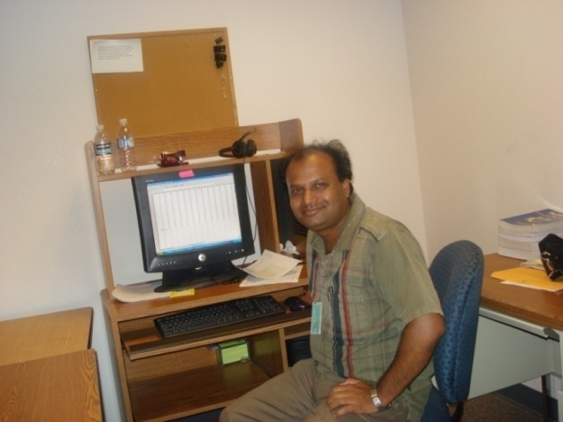
First to obtain a PhD Degree
Writing new Books on ICTE
Publishing my existing books in English
To do something new in the field of Education

Slide 11

CEP 758, Spring 2008
Mokter Hossain

